Slide 1

Family In Xylophone-house
Kim NaKyung
Lim HyunJeong
Jeon HuiJae
Xia Zilei
Hong HyeJin
김나경
임현정
전희재
하자뢰
홍혜진

Slide 2
INDEX
Background
Research
Project Progress
Project Plans
Background
Research
Project Progress
Project Plans

Slide 3
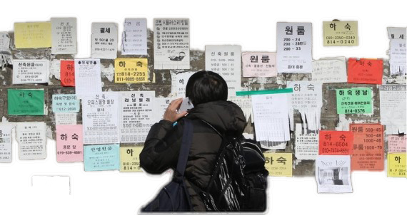




Background
sources : Seoul Department of Housing Policy , http://www.homesharenl.ca/
https://www.wolyo.co.kr:446/news/articleView.html?idxno=31769,
Notes:
홈쉐어링 : 독거노인의 문제와 학생들의 주거문제를 동시에 해결
현재 프랑스, 캐나다, 뉴욕 등에서 성공적으로 시행 중
Generation Empathy under a Roof

Slide 4
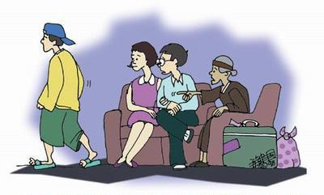
Background
sources : Seoul Department of Housing Policy
Notes:
그런데 우리나라 정책 시행했는데 잘 안됨, 왜냐하면
어르신들의 참여율이 매우 낮음
어르신과 학생들이 잘 맞지 않음

Slide 5
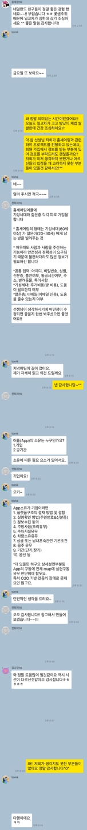

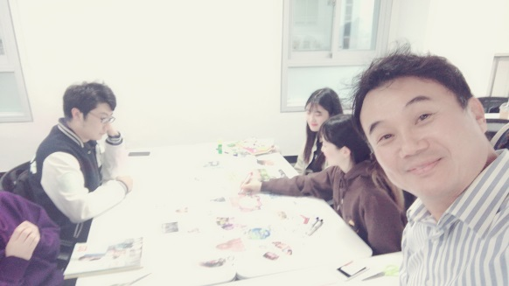
Research
Senior’s Participation
Security
the elderly’s Participation
the elderly’s Participation
Security
Resolve misunderstandings between generations
Lifestyle
Notes:
방안을 모색하여봄
어르신의 참여 : 실제로 어르신들이 같이 지내는 것에 대한
안전성 문제 :
세대 간의 갈등을 해소
같이 사는 두 사람의 생활

Slide 6
Project Progress
Communication
-communicate before/after matched
-coping with an emergency
-allow a moderator to handle conflicts
Matching Algorithm
-evaluating function for conditions and lifestyle that registrants entered
-guarantee security based on sufficient information
Sign up Page
-create database for
The elderly and Student registrants
Customizing Contracts
- Via communication, contracts can be modified
-Students edit,
The elderly approve
Certification
-with email, ID card image
-guarantee security based on sufficient information
Notes:
회원가입 구성**
매칭 프로그램 구성
소통 기능**
최종 계약*
인증**

Slide 7
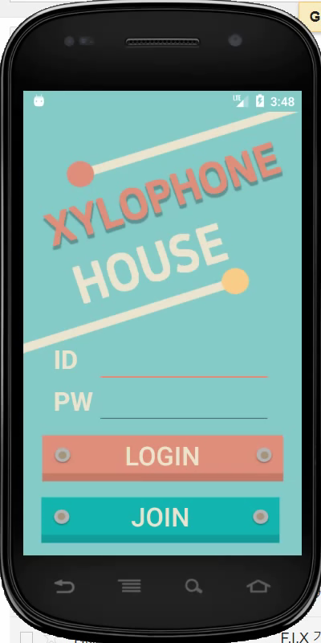
Project Progress – functioning video
Notes:
회원가입 구성
매칭 프로그램 구성
소통 기능
최종 계약

Slide 8
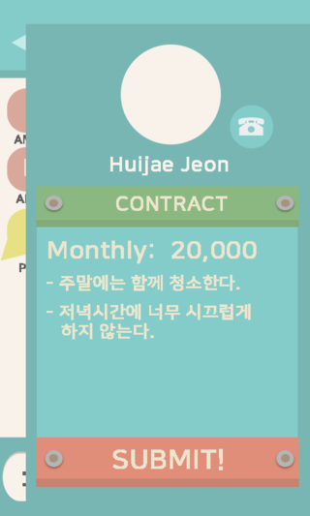
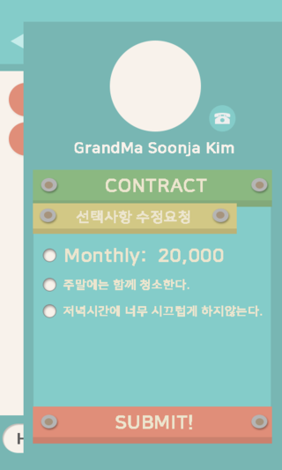
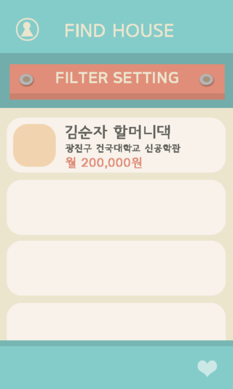
Project Plans
Contract System
On default contract
Student : Edit
Senior : Approve
customizing own contract
Matching Algorithm
Show the list of house based on conditions

Slide 9
Dank je wel!
Thank You!
감사합니다!

